Slide 1
Markov Chains
Tutorial
.

Slide 2
Statistical Parameter Estimation
Reminder
Model
Data set
The basic paradigm:
MLE / bayesian approach
Input data: series of observations X₁, X₂ … X_{t}
  -We assumed observations were i.i.d (independent identical distributed)
Parameters: Θ
Heads - P(H)
Tails - 1-P(H)
.

Slide 3
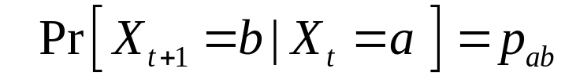
Markov Process
• Markov Property: The state of the system at time t+1 depends only on the state of the system at time t
X₁
X₂
X₃
X₄
X₅
• Stationary Assumption: Transition probabilities are independent of time (t)
Bounded memory transition model

Slide 4
Markov Process
Simple Example
Weather:
raining today 40% rain tomorrow
60% no rain tomorrow
not raining today 20% rain tomorrow
80% no rain tomorrow
Stochastic FSM:
0.4
0.6
0.8
rain
no rain
0.2

Slide 5
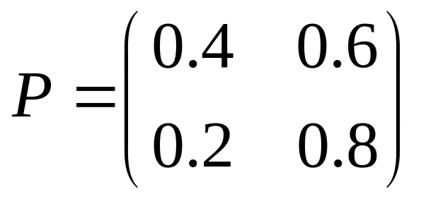
Markov Process
Simple Example
Weather:
raining today 40% rain tomorrow
60% no rain tomorrow
not raining today 20% rain tomorrow
80% no rain tomorrow
The transition matrix:
Stochastic matrix:
  Rows sum up to 1
Double stochastic matrix:
  Rows and columns sum up to 1

Slide 6
Markov Process
Gambler’s Example
– Gambler starts with $10
- At each play we have one of the following:
  • Gambler wins $1 with probability p
  • Gambler looses $1 with probability 1-p
– Game ends when gambler goes broke, or gains a fortune of $100
  (Both 0 and 100 are absorbing states)
p
p
p
p
0
1
2
99
100
1-p
Start (10$)
1-p
1-p
1-p

Slide 7


Markov Process
Markov process - described by a stochastic FSM
Markov chain - a random walk on this graph
(distribution over paths)
Edge-weights give us
We can ask more complex questions, like
p
p
p
p
0
1
2
99
100
1-p
Start (10$)
1-p
1-p
1-p

Slide 8
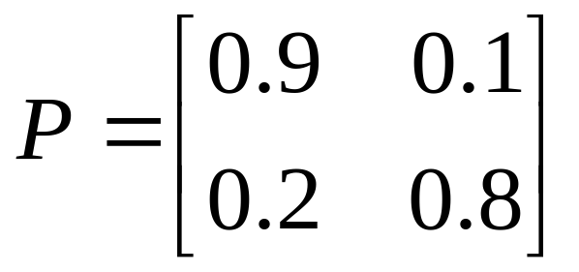
Markov Process
Coke vs. Pepsi Example
Given that a person’s last cola purchase was Coke, there is a 90% chance that his next cola purchase will also be Coke.
If a person’s last cola purchase was Pepsi, there is an 80% chance that his next cola purchase will also be Pepsi.
transition matrix:
0.1
0.9
0.8
coke
pepsi
0.2

Slide 9
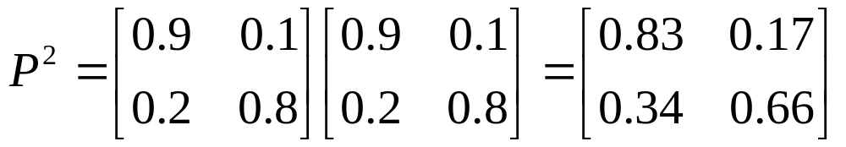
Markov Process
Coke vs. Pepsi Example (cont)
Given that a person is currently a Pepsi purchaser, what is the probability that he will purchase Coke two purchases from now?
Pr[ Pepsi→?→Coke ] =
Pr[ Pepsi→Coke→Coke ] + Pr[ Pepsi→ Pepsi →Coke ] =
0.2 * 0.9 + 0.8 * 0.2 = 0.34
Pepsi → ?
? → Coke

Slide 10
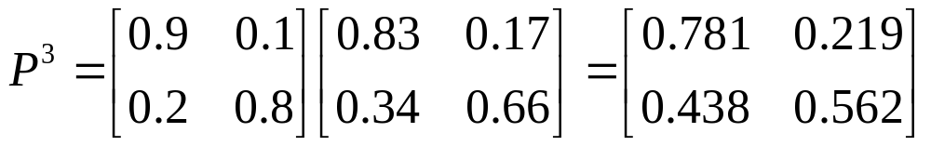
Markov Process
Coke vs. Pepsi Example (cont)
Given that a person is currently a Coke purchaser, what is the probability that he will purchase Pepsi three purchases from now?

Slide 11
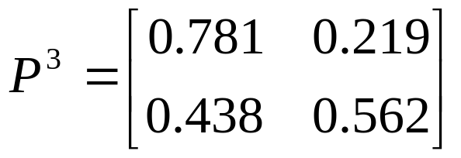
Markov Process
Coke vs. Pepsi Example (cont)
Assume each person makes one cola purchase per week
Suppose 60% of all people now drink Coke, and 40% drink Pepsi
What fraction of people will be drinking Coke three weeks from now?
Pr[X₃=Coke] = 0.6 * 0.781 + 0.4 * 0.438 = 0.6438
Q_{i} - the distribution in week i
Q₀=(0.6,0.4) - initial distribution
Q₃= Q₀ * P³ =(0.6438,0.3562)

Slide 12
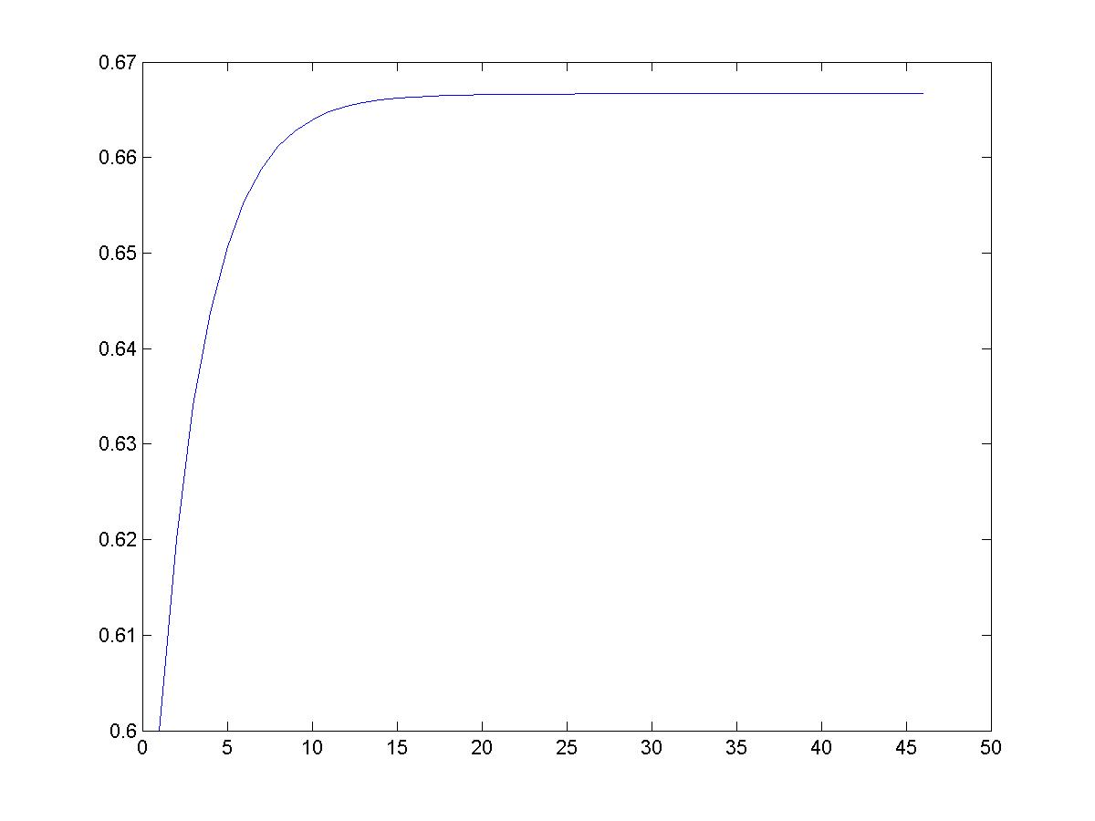
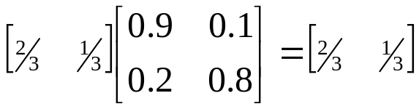
Markov Process
Coke vs. Pepsi Example (cont)
Simulation:
2/3
Pr[X_{i} = Coke]
stationary distribution
0.9
0.1
0.8
coke
pepsi
0.2
week - i

Slide 13
Hidden Markov Models - HMM
Hidden states
H₁
H₂
H_{i}
H_{L-1}
H_{L}
X₁
X₂
X_{i}
X_{L-1}
X_{L}
Observed data

Slide 14
Hidden Markov Models - HMM
Coin-Tossing Example
0.9
0.9
0.1
transition probabilities
fair
loaded
0.1
1/2
1/2
3/4
1/4
emission probabilities
H
T
H
T
Fair/Loaded
H₁
H₂
H_{i}
H_{L-1}
H_{L}
X₁
X₂
X_{i}
X_{L-1}
X_{L}
Head/Tail

Slide 15
Hidden Markov Models - HMM
C-G Islands Example
C-G islands: Genome regions which are very rich in C and G
q/4
A
G
q/4
P
q
Regular
DNA
P
change
q
P
q
P
q
C
q/4
T
q/4
p/6
p/3
(1-P)/4
A
G
C-G island
(1-q)/6
(1-q)/3
P/6
p/3
T
C

Slide 16
Hidden Markov Models - HMM
C-G Islands Example
change
G
G
A
C
A
C
T
T
C-G / Regular
H₁
H₂
H_{i}
H_{L-1}
H_{L}
X₁
X₂
X_{i}
X_{L-1}
X_{L}
{A,C,G,T}
To be continued…

